Slide 1
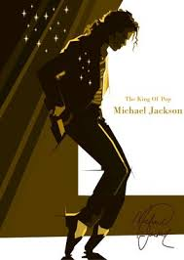
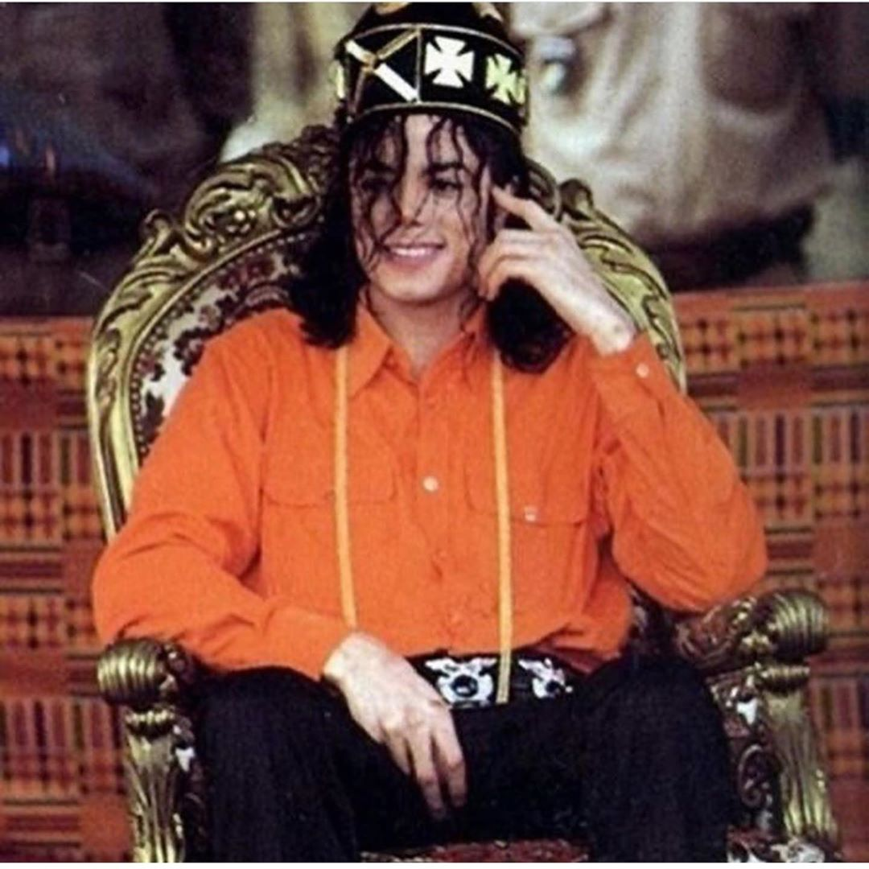
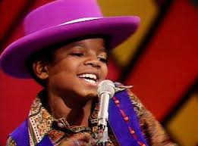
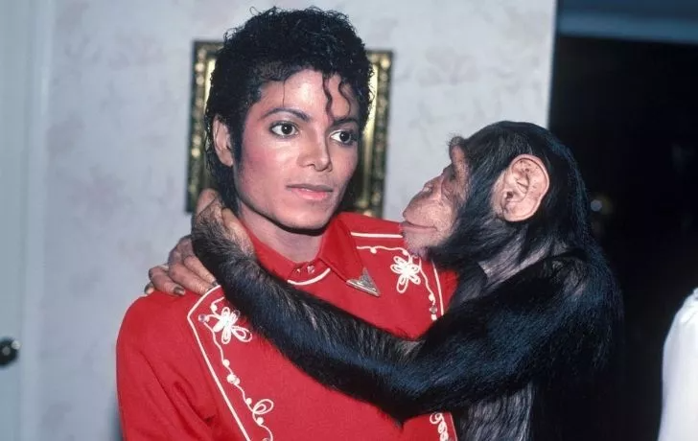
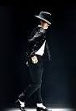
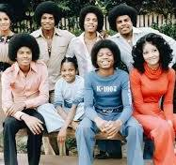
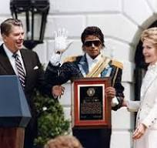
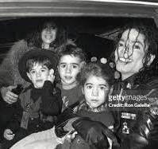
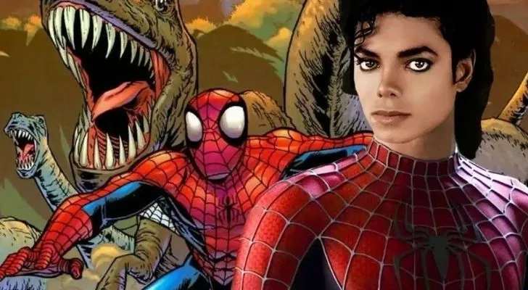
He first sang in public when he was 5 years old (in 1963)!
Michael Jackson was an amazing singer and dancer, loved his family, and he helped a lot of people! He also liked to have fun, just like us!
He was the “King of Pop.” He won many awards, and he was so popular! But, he also really was a king (of a small village in Africa where his ancestors lived)!
He helped many people. He got awards from two presidents for all of his help!
Jackson once had a pet chimpanzee called Bubbles.
He had 9 brothers and sisters.
And he was a big Spiderman fan. He tried to buy Marvel Comics!
Jackson invented a famous dance – the Moonwalk!
And he had 4 kids!

Slide 2
He first sang in public when he was 5 years old (in 1963)!
Michael Jackson was an amazing singer and dancer, loved his family, and he helped a lot of people! He also liked to have fun, just like us!
He was the “King of Pop.” He won many awards, and he was so popular! But, he also really was a king (of a small village in Africa where his ancestors lived)!
He helped many people. He got awards from two presidents for all of his help!
Jackson once had a pet chimpanzee called Bubbles.
He had 9 brothers and sisters.
And he was a big Spiderman fan. He tried to buy Marvel Comics!
Jackson invented a famous dance – the Moonwalk!
And he had 4 kids!

Slide 3
He first sang in public when he was 5 years old (in 1963)!
Michael Jackson was an amazing singer and dancer, loved his family, and he helped a lot of people! He also liked to have fun, just like us!
He was the “King of Pop.” He won many awards, and he was so popular! But, he also really was a king (of a small village in Africa where his ancestors lived)!
He helped many people. He got awards from two presidents for all of his help!
Jackson once had a pet chimpanzee called Bubbles.
He had 9 brothers and sisters.
And he was a big Spiderman fan. He tried to buy Marvel Comics!
Jackson invented a famous dance – the Moonwalk!
And he had 4 kids!

Slide 4
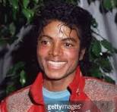
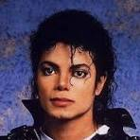
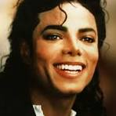
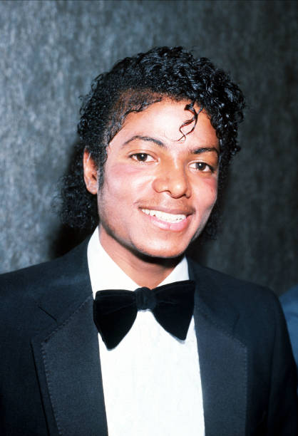
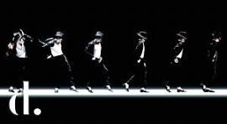
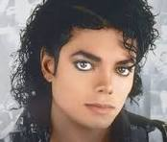

Slide 5
He first sang in public when he was 5 years old (in 1963)!
Michael Jackson was an amazing singer and dancer, loved his family, and he helped a lot of people! He also liked to have fun, just like us!
He was known as the “King of Pop.” He won many awards, and he was so popular! But, he also really was a king (of a small village in Africa where his ancestors lived)!
He helped many people. He got awards from two presidents for all of his help!
Jackson once had a pet chimpanzee called Bubbles.
He had 9 brothers and sisters.
And he was a big Spiderman fan. He tried to buy Marvel Comics!
He invented a famous dance – the Moonwalk!
And he had 4 kids!

